Slide 1
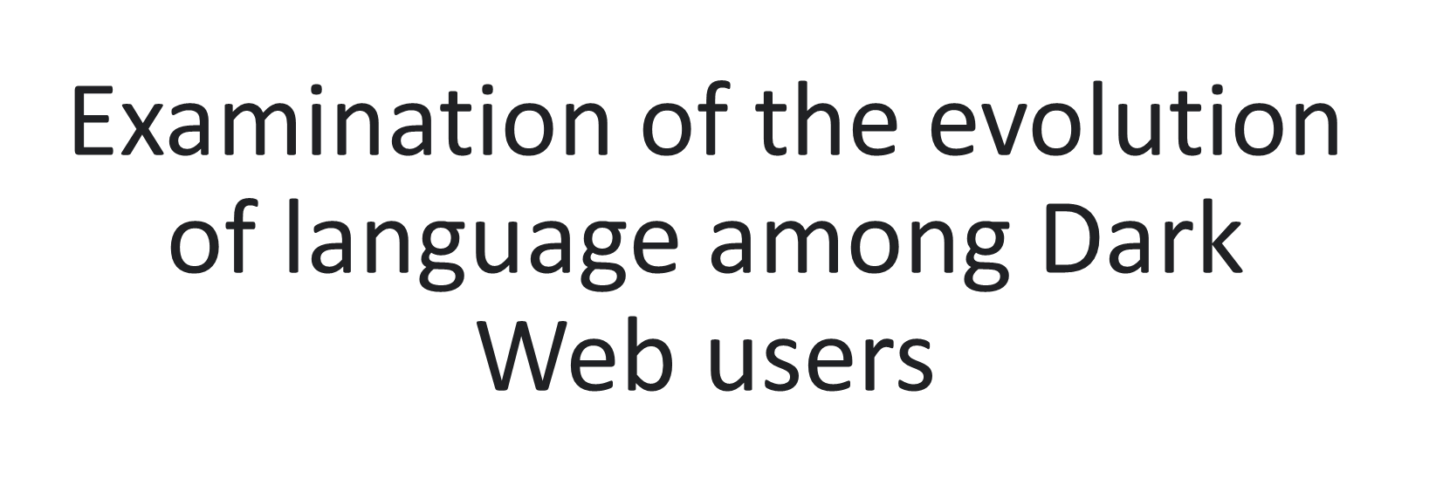


Mentor: Andrea Underhill, Jane Daquin

Slide 2
Project Objective
Identify relevant topics, trends, and sentiment in user conversations on the Dark Web.
Study the evolution of these topics over time.
Employ NLP and Machine Learning techniques for analysis.

Slide 3
Why This Work is Important
Insights: Helps understand criminal activities and how their language changes, useful for police and researchers.
Robust Approach: Analyzed data from three forums for a more complete view.
Multimodal Aspect: Trained a visual model incorporating images to gain deeper insights.

Slide 4
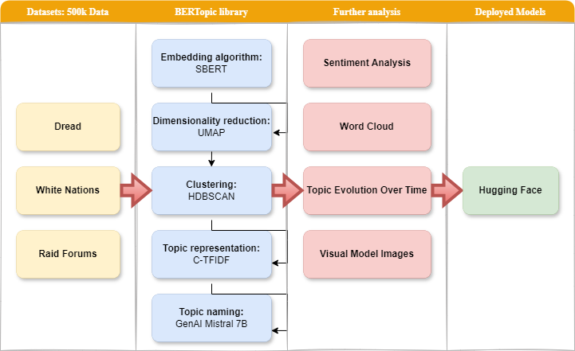
Methodology

Slide 5
Findings: Main Topics
5 Baselines with 3 Different Datasets: 7, 68, 121, 26 and 31 topics merged into one with 173 distinct topics
Examples:
Drug sales
Hacking
Vendor reviews
Bitcoin
Fraud
PGP key
Opsec questions
Conspiracies
Wars
Corruption
Pedophilia
Rigged elections
Data breaches

Slide 6
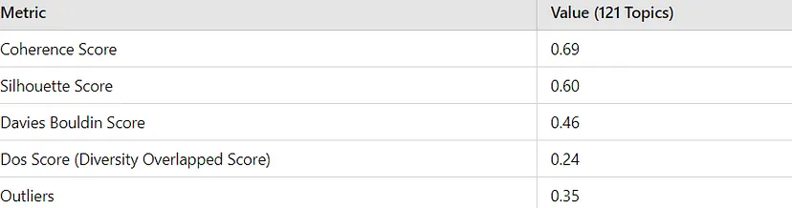
Validating Topics: Clustering Metrics

Slide 7
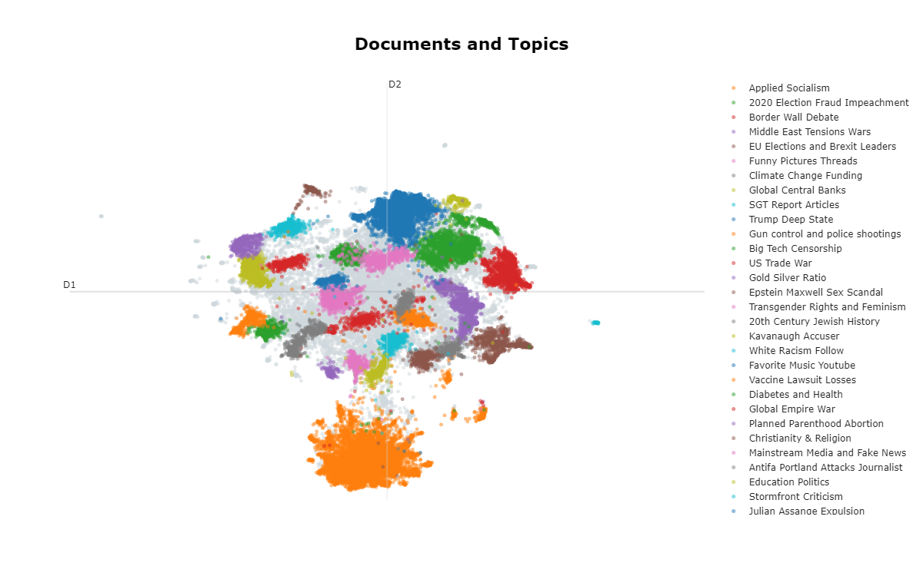
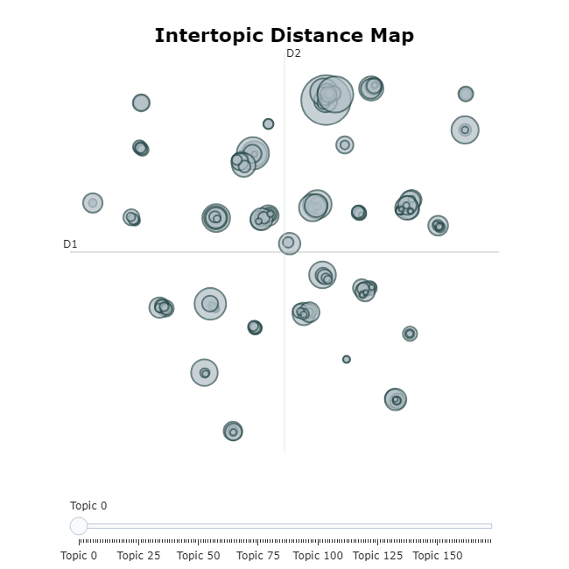
Validating Topics: Graphs
Merged: 173 Topics
Single: 31 Topics

Slide 8
Findings: Evolution Over Time
Analysis: Keyword changes over time for each topic.
Tools: BERTopic module, LSTM.
Visualization: Time series plots of topic distribution.

Slide 9
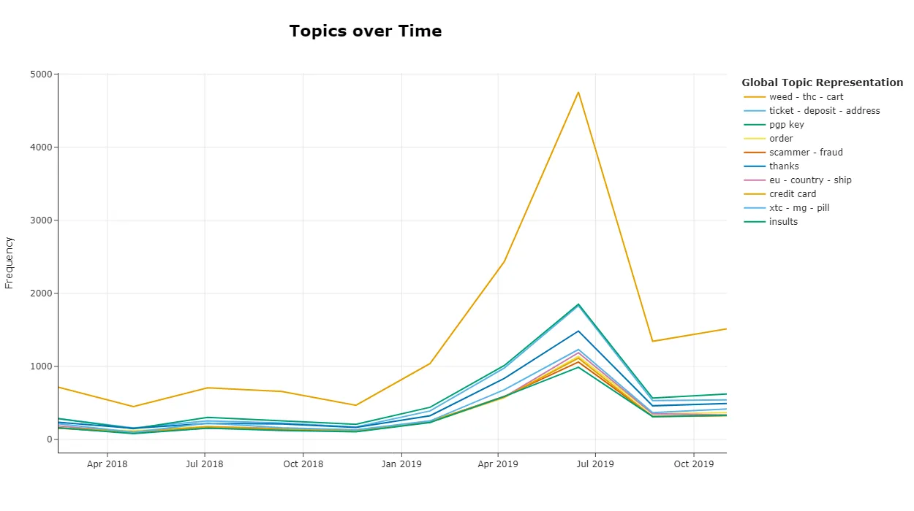
Topic Distribution Over Time
Topic 9: 2019: (pill, mg, pharma, price, xtc) | 2020: (mg, pill, price, xtc, mdma)

Slide 10
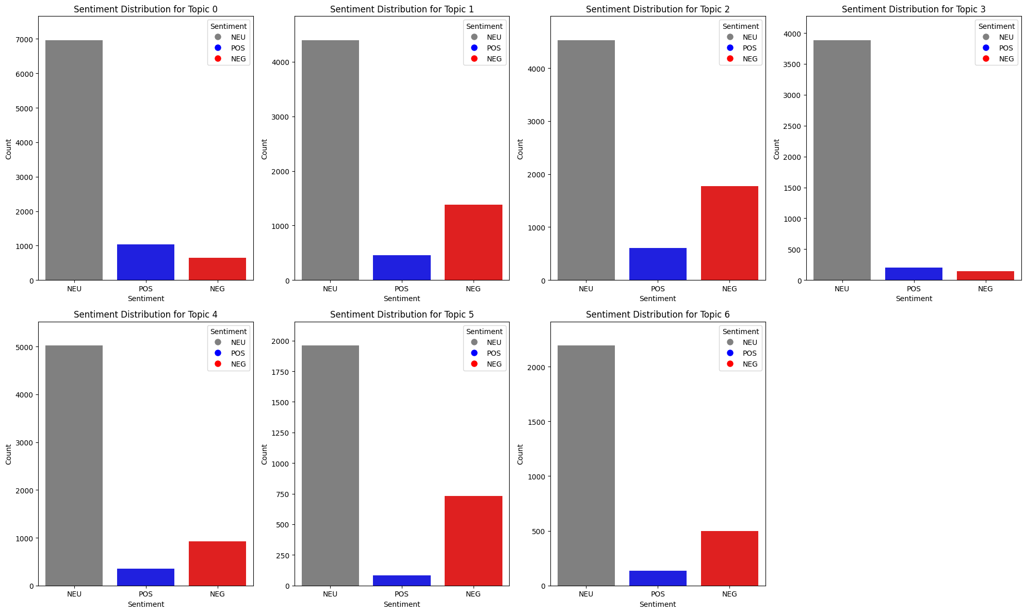
Sentiment Analysis: Example of 7 Topics

Slide 11
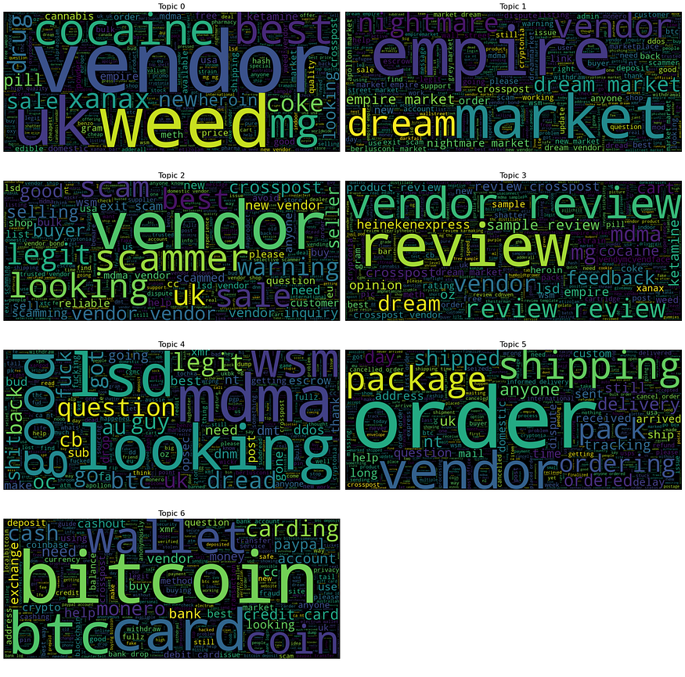
Word Cloud: Example of 7 Topics

Slide 12

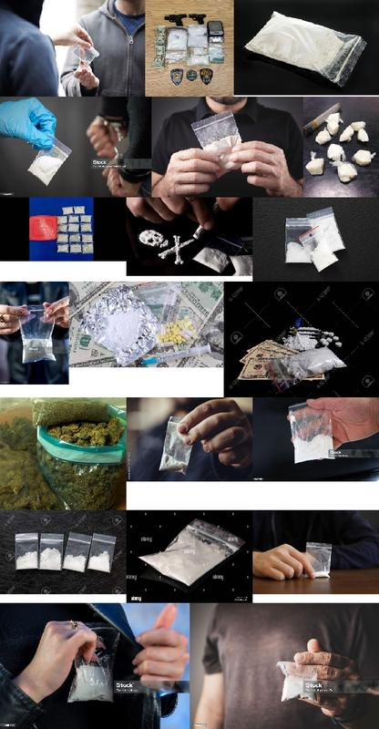
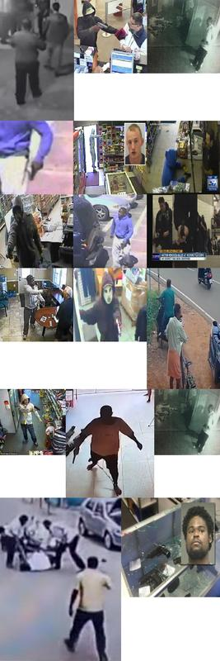

Visual Model: 4 Topics from External Dataset
Guns
Drugs
Robbers
People

Slide 13
Next Steps
Incorporating Dark Web Images: Integrating dark web images will enhance the model’s ability to categorize and understand visual content.
Expanding Dataset and Topics: Adding more data and topics will improve the model’s accuracy and coverage.
Real-Time Monitoring: Implementing real-time tracking with expert input will allow for more precise analysis of evolving trends on the dark web.

Slide 14
Thank You!

